Slide 1
Hi! This is CS50.
Healthy snacks for break today: 🍎, 🍌, 🍐, and 🍊.
If your (potential) concentration requires letter grades (LG) for concentration credit, be sure to change from SAT/UNS (SUS) to LG by 5pm today, per website.
CS50 Lunch this Fri 10/11, 1:15pm, RSVP at cs50.harvard.edu/lunch to attend.
If you have trouble seeing projector, see live.cs50.io/screen for live feed.
Quiz 5 due tomorrow at 10:30am.
Problem Set 5 due Sun 10/13 at 11:59pm.
Supersection tonight at 7:30pm via Zoom.
Lots of tutorials available this week!
No lecture, section, or pset next week (for CS50's October Recess).

Slide 2
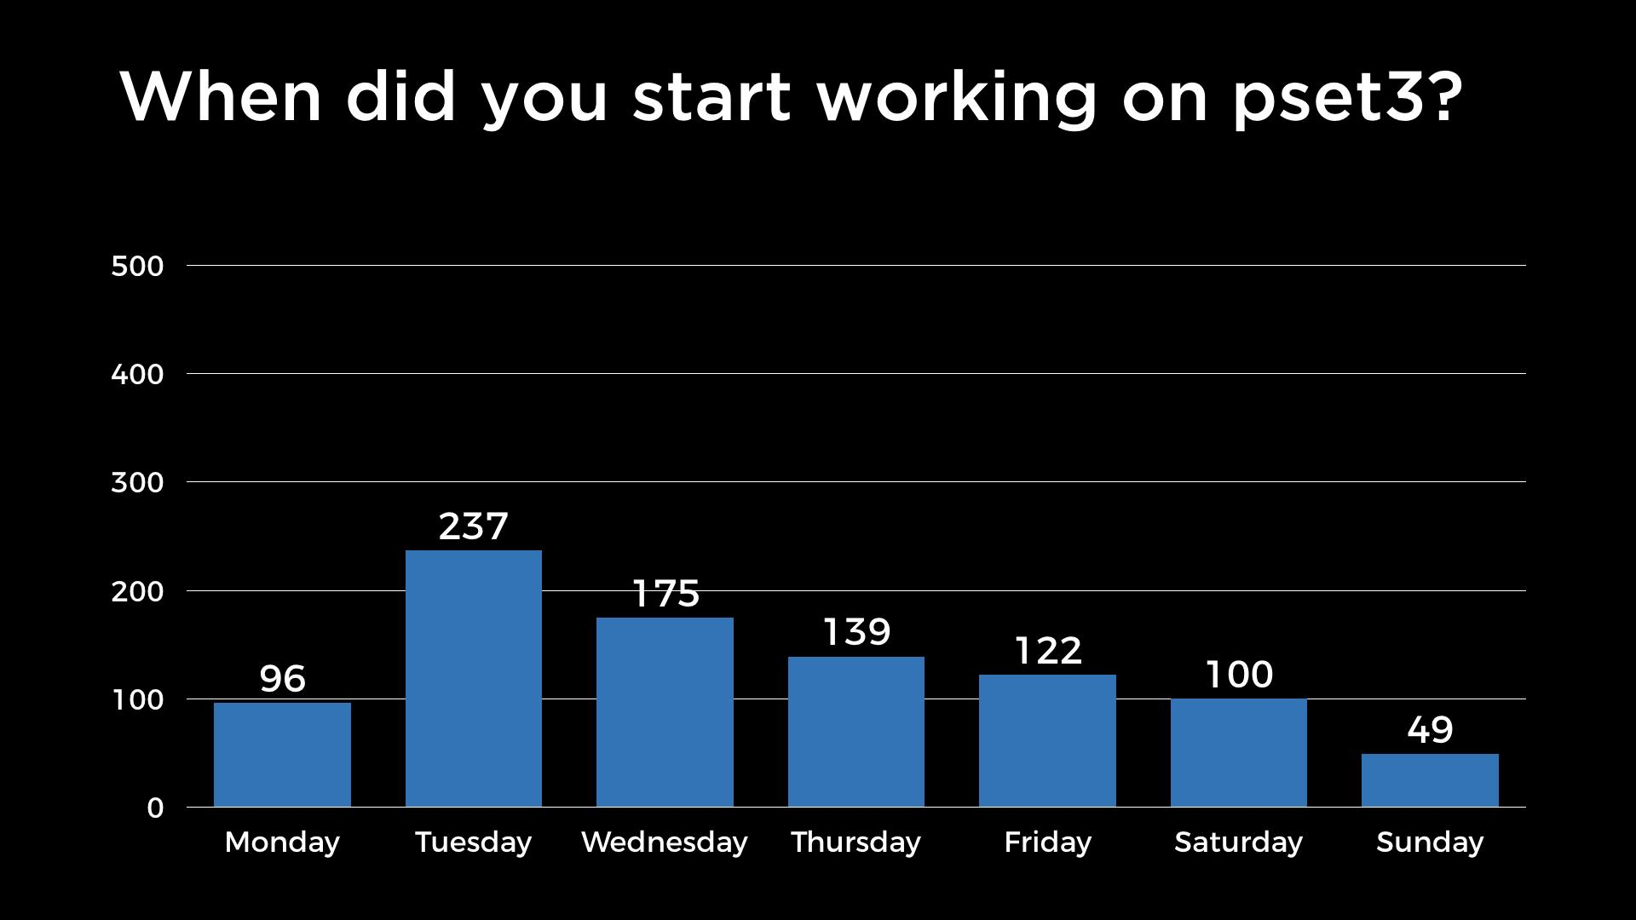

Slide 3
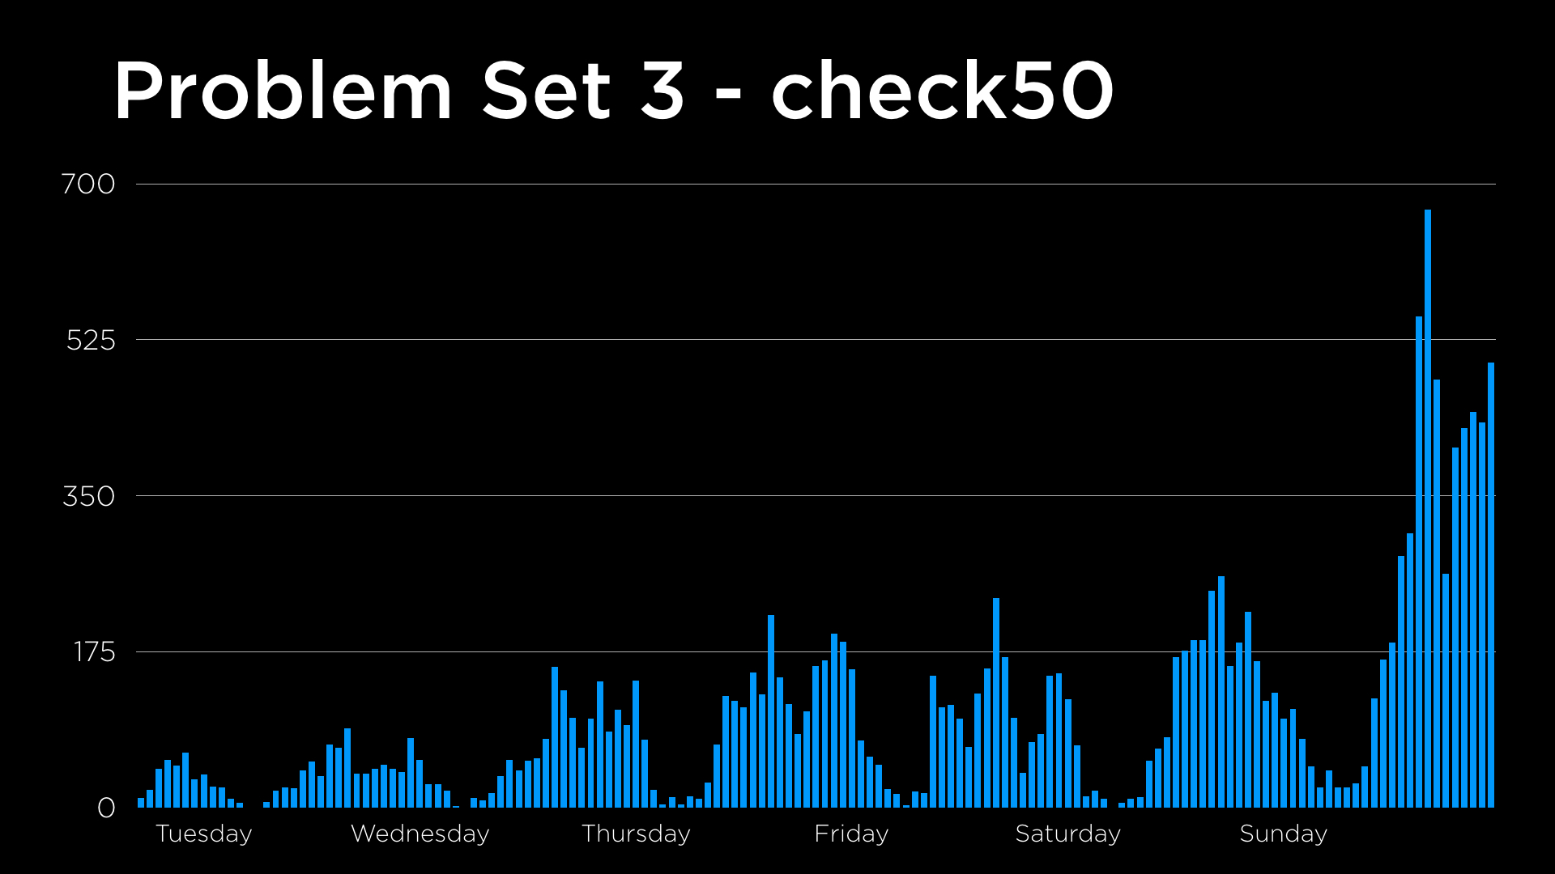
use of check50 for pset3

Slide 4
This is CS50

Slide 5
int main(void)
{
int *x;
int *y;
x = malloc(sizeof(int));
*x = 42;
*y = 13;
}

Slide 6
int main(void)
{
int *x;
int *y;
x = malloc(sizeof(int));
*x = 42;
*y = 13;
}

Slide 7
int main(void)
{
int *x;
int *y;
x = malloc(sizeof(int));
*x = 42;
*y = 13;
}

Slide 8
int main(void)
{
int *x;
int *y;
x = malloc(sizeof(int));
*x = 42;
*y = 13;
}

Slide 9
int main(void)
{
int *x;
int *y;
x = malloc(sizeof(int));
*x = 42;
*y = 13;
}

Slide 10
int main(void)
{
int *x;
int *y;
x = malloc(sizeof(int));
*x = 42;
*y = 13;
}

Slide 11
int main(void)
{
int *x;
int *y;
x = malloc(sizeof(int));
*x = 42;
*y = 13;
}

Slide 12
int main(void)
{
int *x;
int *y;
x = malloc(sizeof(int));
*x = 42;
}

Slide 13
int main(void)
{
int *x;
int *y;
x = malloc(sizeof(int));
*x = 42;
y = x;
*y = 13;
}

Slide 14
int main(void)
{
int *x;
int *y;
x = malloc(sizeof(int));
*x = 42;
y = x;
*y = 13;
}

Slide 15
int main(void)
{
int *x;
int *y;
x = malloc(sizeof(int));
*x = 42;
y = x;
*y = 13;
}

Slide 16
int main(void)
{
int *x;
int *y;
x = malloc(sizeof(int));
*x = 42;
y = x;
*y = 13;
}

Slide 17
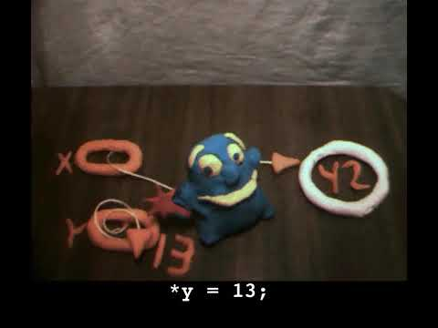

Slide 18
arrays

Slide 20
 | 1 | 2 | 3

Slide 21
 | 1 | 2 | 3

Slide 22
 | 1 | 2 | 3

Slide 23
M | M | A | \0 | E | M | M | A
\0 | 1 | 2 | 3 | E | M | M | A
\0 | E | M | M | A | \0 | E | M
M | A | \0

Slide 24
 | 1 | 2 | 3

Slide 25
 | 1 | 2 | 3
 |  |  | 1

Slide 26
 | 1 | 2 | 3
 |  |  | 1 | 2

Slide 27
 | 1 | 2 | 3
 |  |  | 1 | 2 | 3

Slide 28
 |  |  | 1 | 2 | 3

Slide 29
 |  |  | 1 | 2 | 3 | 4
Notes:
list{0,1,2}.c

Slide 30
O(n²)
O(n log n)
O(n)
O(log n)
O(1)

Slide 31
O(n²)
O(n log n)
O(n)
O(log n) search
O(1)

Slide 32
O(n²)
O(n log n)
O(n) insert
O(log n) search
O(1)

Slide 33
data structures

Slide 34
struct
.
*

Slide 35
struct
->

Slide 36
linked lists

Slide 38
 | 1 0x123

Slide 39
 | 1 0x123
 |  |  | 2 0x456

Slide 40
 | 1 0x123
 |  |  | 2 0x456
 |  |  |  |  | 3 0x789

Slide 41
 | 1 0x123
 |  |  | 2 0x456
 |  |  |  |  | 3 0x789

Slide 42
 | 1 0x123
 | 0x456 |  | 2 0x456
 |  |  |  |  | 3 0x789

Slide 43
 | 1 0x123
 | 0x456 |  | 2 0x456
 |  |  | 0x789 |  | 3 0x789

Slide 44
 | 1 0x123
 | 0x456 |  | 2 0x456
 |  |  | 0x789 |  | 3 0x789
 |  |  |  |  | 0x0

Slide 45
 | 1 0x123
 | 0x456 |  | 2 0x456
 |  |  | 0x789 |  | 3 0x789
 |  |  |  |  | NULL

Slide 46
 | 1
 |  |  | 2
 |  |  |  |  | 3

Slide 47
typedef struct
{
string name;
string number;
}
person;

Slide 48
typedef struct
{
}
person;

Slide 49
typedef struct
{
}
node;

Slide 50
typedef struct
{
}
node;

Slide 51
typedef struct
{
int number;
}
node;

Slide 52
typedef struct
{
int number;
node *next;
}
node;

Slide 53
typedef struct node
{
int number;
node *next;
}
node;

Slide 54
typedef struct node
{
int number;
struct node *next;
}
node;

Slide 55
list

Slide 56
node *list = NULL;

Slide 57
list

Slide 58
list
2

Slide 59
node *n = malloc(sizeof(node));

Slide 60
node *n = malloc(sizeof(node));
(*n).number = 2;

Slide 61
node *n = malloc(sizeof(node));
n->number = 2;

Slide 62
node *n = malloc(sizeof(node));
n->number = 2;
n->next = NULL;

Slide 63
node *n = malloc(sizeof(node));
if (n != NULL)
{
n->number = 2;
n->next = NULL;
}

Slide 64
list
2

Slide 65
list
2

Slide 66
list = n;

Slide 67
list
2

Slide 68
4
list
2

Slide 69
node *n = malloc(sizeof(node));
if (n != NULL)
{
n->number = 4;
n->next = NULL;
}

Slide 70
4
list
2

Slide 71
4
list
2

Slide 72
node *tmp = list;

Slide 73
node *tmp = list;
while (tmp->next != NULL)
{
}

Slide 74
node *tmp = list;
while (tmp->next != NULL)
{ tmp = tmp->next;
}

Slide 75
node *tmp = list;
while (tmp->next != NULL)
{ tmp = tmp->next;
}
tmp->next = n;

Slide 76
4
list
2

Slide 77
4
list
2
5

Slide 78
node *n = malloc(sizeof(node));
if (n != NULL)
{
n->number = 5;
n->next = NULL;
}

Slide 79
4
list
2
5

Slide 80
4
list
2
5

Slide 81
node *tmp = list;
while (tmp->next != NULL)
{ tmp = tmp->next;
}
tmp->next = n;

Slide 82
4
list
2
5

Slide 83
4
list
2
5
1

Slide 84
node *n = malloc(sizeof(node));
if (n != NULL)
{
n->number = 1;
n->next = NULL;
}

Slide 85
4
list
2
5
1

Slide 86
4
list
2
5
1

Slide 87
4
list
2
5
1

Slide 88
4
list
2
5
1

Slide 89
4
list
2
5
1

Slide 90
4
list
2
5
1

Slide 91
n->next = list;
list = n;

Slide 92
4
list
2
5
1

Slide 93
4
list
2
5
1
3

Slide 94
4
list
2
5
1
3

Slide 95
4
list
2
5
1
3
Notes:
volunteers
list3.c

Slide 96
4
list
2
5
1
3

Slide 97
4
list
2
5
1
3

Slide 98
4
list
2
5
1
3

Slide 99
4
list
2
5
1
3

Slide 100
4
list
2
5
1
3

Slide 101
4
list
2
5
1
3

Slide 102
4
list
2
5
1
3

Slide 103
O(n²)
O(n log n)
O(n)
O(log n)
O(1)

Slide 104
O(n²)
O(n log n)
O(n) search
O(log n)
O(1)

Slide 105
O(n²)
O(n log n)
O(n) search, insert
O(log n)
O(1)

Slide 106
trees

Slide 107
binary search trees

Slide 108
 | 1 | 2 | 3 | 4 | 5 | 6 | 7

Slide 109
 | 1 | 2 | 3 | 4 | 5 | 6 | 7

Slide 110
 | 1 | 2 | 3 | 4 | 5 | 6 | 7

Slide 111
 | 1 | 2 | 3 | 4 | 5 | 6 | 7

Slide 112
4
2
6
1
3
5
7

Slide 113
4
2
6
1
3
5
7

Slide 114
typedef struct node
{
int number;
struct node *next;
}
node;

Slide 115
typedef struct node
{
int number;
}
node;

Slide 116
typedef struct node
{
int number;
}
node;

Slide 117
typedef struct node
{
int number;
struct node *left;
struct node *right;
}
node;

Slide 118
4
2
6
1
3
5
7

Slide 119
bool search(node *tree)
{
}

Slide 120
bool search(node *tree)
{
if (tree == NULL)
{
return false;
}
}

Slide 121
bool search(node *tree)
{
if (tree == NULL)
{
return false;
}
else if (50 < tree->number)
{
return search(tree->left);
}
}

Slide 122
bool search(node *tree)
{
if (tree == NULL)
{
return false;
}
else if (50 < tree->number)
{
return search(tree->left);
}
else if (50 > tree->number)
{
return search(tree->right);
}
}

Slide 123
bool search(node *tree)
{
if (tree == NULL)
{
return false;
}
else if (50 < tree->number)
{
return search(tree->left);
}
else if (50 > tree->number)
{
return search(tree->right);
}
else if (50 == tree->number)
{
return true;
}
}

Slide 124
bool search(node *tree)
{
if (tree == NULL)
{
return false;
}
else if (50 < tree->number)
{
return search(tree->left);
}
else if (50 > tree->number)
{
return search(tree->right);
}
else
{
return true;
}
}

Slide 125
O(n²)
O(n log n)
O(n)
O(log n)
O(1)

Slide 126
O(n²)
O(n log n)
O(n)
O(log n) search
O(1)

Slide 127
O(n²)
O(n log n)
O(n)
O(log n) search, insert
O(1)

Slide 128
hash tables

Slide 130
0
1
2
3
4
5
6
7
8
9
10
11
12
13
14
15
16
17
18
19
20
21
22
23
24
25

Slide 131
A
B
C
D
E
F
G
H
I
J
K
L
M
N
O
P
Q
R
S
T
U
V
W
X
Y
Z

Slide 133
Albus

Slide 134
Albus
Zacharias

Slide 135
Albus
Hermione
Zacharias

Slide 136
Albus
Ginny
Hermione
Zacharias

Slide 137
Albus
Ginny
Hermione
Ron
Zacharias

Slide 138
Albus
Fred
Ginny
Hermione
Ron
Zacharias

Slide 139
Albus
Fred
Ginny
Hermione
Ron
Severus
Zacharias

Slide 140
Albus
Fred
Ginny
Hermione
Petunia
Ron
Severus
Zacharias

Slide 141
Albus
Draco
Fred
Ginny
Hermione
Petunia
Ron
Severus
Zacharias

Slide 142
Albus
Draco
Fred
Ginny
Hermione
James
Petunia
Ron
Severus
Zacharias

Slide 143
Albus
Cedric
Draco
Fred
Ginny
Hermione
James
Petunia
Ron
Severus
Zacharias

Slide 144
Albus
Cedric
Draco
Fred
Ginny
Hermione
James
Luna
Petunia
Ron
Severus
Zacharias

Slide 145
Albus
Cedric
Draco
Fred
Ginny
Hermione
James
Luna
Neville
Petunia
Ron
Severus
Zacharias

Slide 146
Albus
Cedric
Draco
Fred
Ginny
Hermione
James
Kingsley
Luna
Neville
Petunia
Ron
Severus
Zacharias

Slide 147
Albus
Cedric
Draco
Fred
Ginny
Hermione
James
Kingsley
Luna
Minerva
Neville
Petunia
Ron
Severus
Zacharias

Slide 148
Albus
Cedric
Draco
Fred
Ginny
Hermione
James
Kingsley
Luna
Minerva
Neville
Petunia
Ron
Severus
Vernon
Zacharias

Slide 149
Albus
Cedric
Draco
Fred
Ginny
Hermione
Harry
James
Kingsley
Luna
Minerva
Neville
Petunia
Ron
Severus
Vernon
Zacharias

Slide 150
Albus
Cedric
Draco
Fred
Ginny
Hermione
Harry
Hagrid
James
Kingsley
Luna
Minerva
Neville
Petunia
Ron
Severus
Vernon
Zacharias

Slide 151
Albus
Cedric
Draco
Fred
Ginny
Hermione
Harry
Hagrid
James
Kingsley
Luna
Minerva
Neville
Petunia
Ron
Severus
Sirius
Vernon
Zacharias

Slide 152
Albus
Cedric
Draco
Fred
Ginny
Hermione
Harry
Hagrid
James
Kingsley
Luna
Minerva
Neville
Petunia
Ron
Remus
Severus
Sirius
Vernon
Zacharias

Slide 153
Albus
Cedric
Draco
Fred
Ginny
George
Hermione
Harry
Hagrid
James
Kingsley
Luna
Minerva
Neville
Petunia
Ron
Remus
Severus
Sirius
Vernon
Zacharias

Slide 154
Albus
Cedric
Draco
Fred
Ginny
George
Hermione
Harry
Hagrid
James
Kingsley
Luna
Lily
Minerva
Neville
Petunia
Ron
Remus
Severus
Sirius
Vernon
Zacharias

Slide 155
Albus
Cedric
Draco
Fred
Ginny
George
Hermione
Harry
Hagrid
James
Kingsley
Luna
Lily
Lucius
Minerva
Neville
Petunia
Ron
Remus
Severus
Sirius
Vernon
Zacharias

Slide 156
input →
→ output

Slide 157
hash function

Slide 158
Albus →
→ 0

Slide 159
Zacharias →
→ 25

Slide 160
Albus
Cedric
Draco
Fred
Ginny
George
Hermione
Harry
Hagrid
James
Kingsley
Luna
Lily
Lucius
Lavender
Minerva
Neville
Petunia
Ron
Remus
Severus
Sirius
Vernon
Zacharias

Slide 161
Hermione
Harry
Hagrid

Slide 162
A
B
C
D
E
F
G
H
I
J
K
L
M
N
O
P
Q
R
S
T
U
V
W
X
Y
Z
Hermione
Harry
Hagrid

Slide 163
H

Slide 164
Ha

Slide 165
Ha
Hb

Slide 166
Ha
Hb
Hc

Slide 167
Ha
Hb
Hc
Hd

Slide 168
Ha
Hb
Hc
Hd
He

Slide 169
Ha
Hb
Hc
Hd
He
Hf

Slide 170
Ha
Hb
Hc
Hd
He
Hf
Hermione

Slide 171
Ha
Hb
Hc
Hd
He
Hf
Harry
Hermione

Slide 172
Ha
Hb
Hc
Hd
He
Hf
Harry
Hagrid
Hermione
Notes:
676 buckets

Slide 173
Ha

Slide 174
Haa

Slide 175
Haa
Hab

Slide 176
Haa
Hab
Hac

Slide 177
Haa
Hab
Hac
Had

Slide 178
Haa
Hab
Hac
Had
Hae

Slide 179
Haa
Hab
Hac
Had
Hae
Haf

Slide 180
Haa
Hab
Hac
Had
Hae
Haf
Hag
...

Slide 181
Haa
Hab
Hac
Had
Hae
Haf
Hag
...
Haq

Slide 182
Haa
Hab
Hac
Had
Hae
Haf
Hag
...
Haq
Har

Slide 183
Haa
Hab
Hac
Had
Hae
Haf
Hag
...
Haq
Har
Has
...

Slide 184
Haa
Hab
Hac
Had
Hae
Haf
Hag
...
Haq
Har
Has
...
Heq

Slide 185
Haa
Hab
Hac
Had
Hae
Haf
Hag
...
Haq
Har
Has
...
Heq
Her

Slide 186
Haa
Hab
Hac
Had
Hae
Haf
Hag
...
Haq
Har
Has
...
Heq
Her
Hes

Slide 187
Haa
Hab
Hac
Had
Hae
Haf
Hag
...
Haq
Har
Has
...
Heq
Her
Hes
Hermione

Slide 188
Haa
Hab
Hac
Had
Hae
Haf
Hag
...
Haq
Har
Has
...
Heq
Her
Hes
Harry
Hermione

Slide 189
Haa
Hab
Hac
Had
Hae
Haf
Hag
...
Haq
Har
Has
...
Heq
Her
Hes
Hagrid
Harry
Hermione
Notes:
17,576 buckets

Slide 190
O(n²)
O(n log n)
O(n)
O(log n)
O(1)

Slide 191
O(n²)
O(n log n)
O(n)
O(log n)
O(1) search

Slide 192
O(n²)
O(n log n)
O(n) search
O(log n)
O(1)

Slide 193
O(n²)
O(n log n)
O(n) search, insert
O(log n)
O(1)

Slide 194
O(n²)
O(n log n)
O(n) search
O(log n)
O(1) insert

Slide 195
Albus
Cedric
Draco
Fred
Ginny
George
Hermione
Harry
Hagrid
James
Kingsley
Luna
Lily
Lucius
Lavender
Minerva
Neville
Petunia
Ron
Remus
Severus
Sirius
Vernon
Zacharias

Slide 196
tries

Slide 197
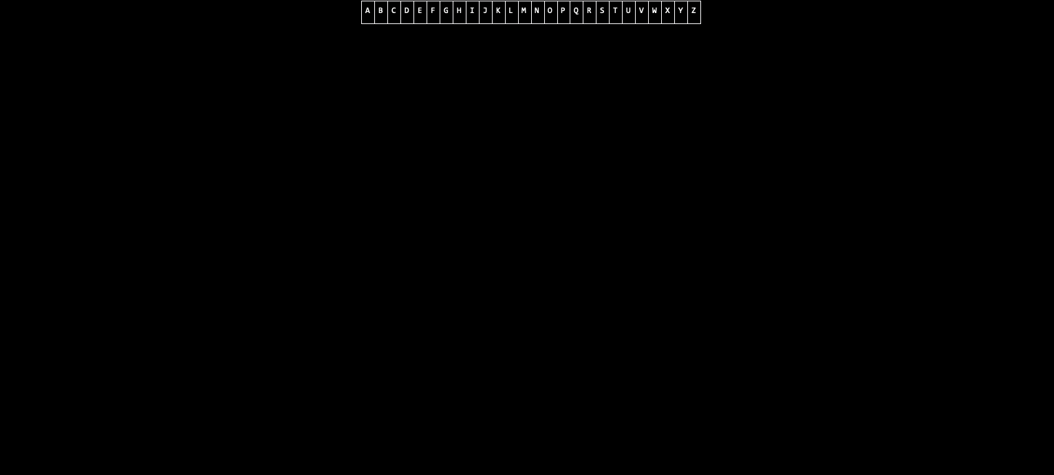

Slide 198
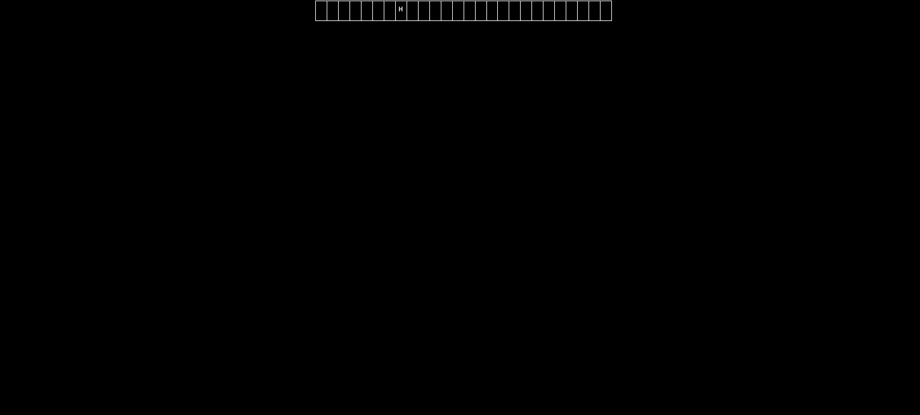

Slide 199
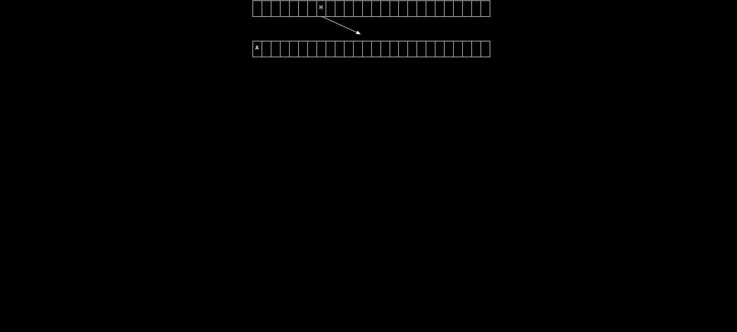

Slide 200
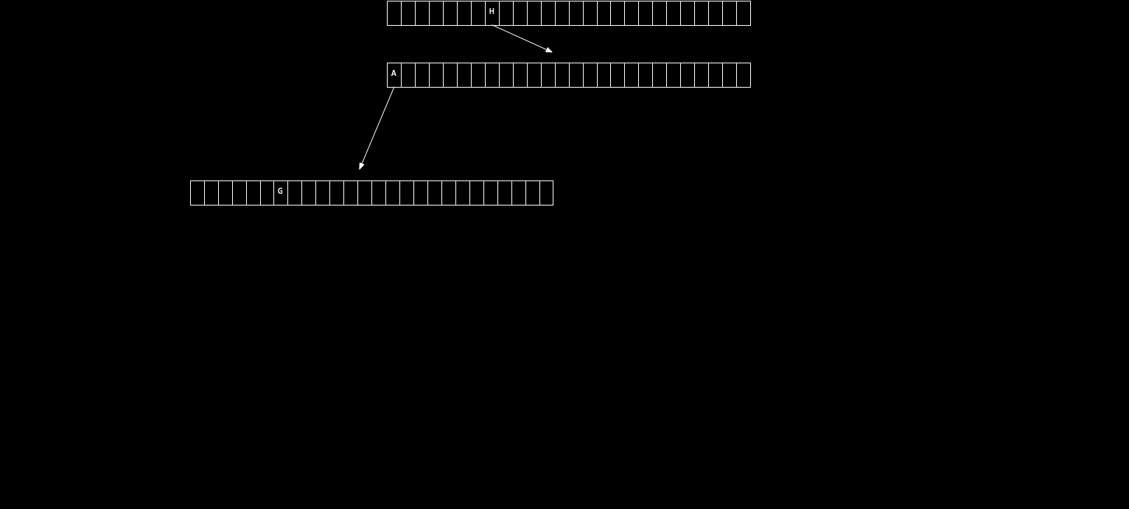

Slide 201
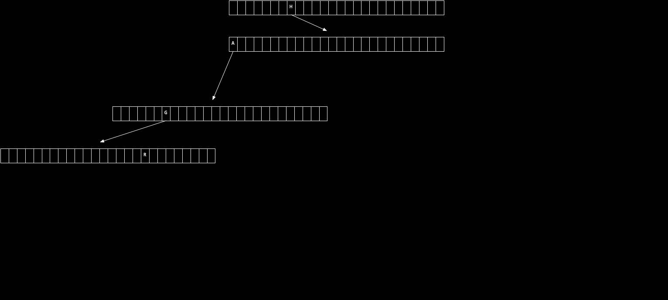

Slide 202
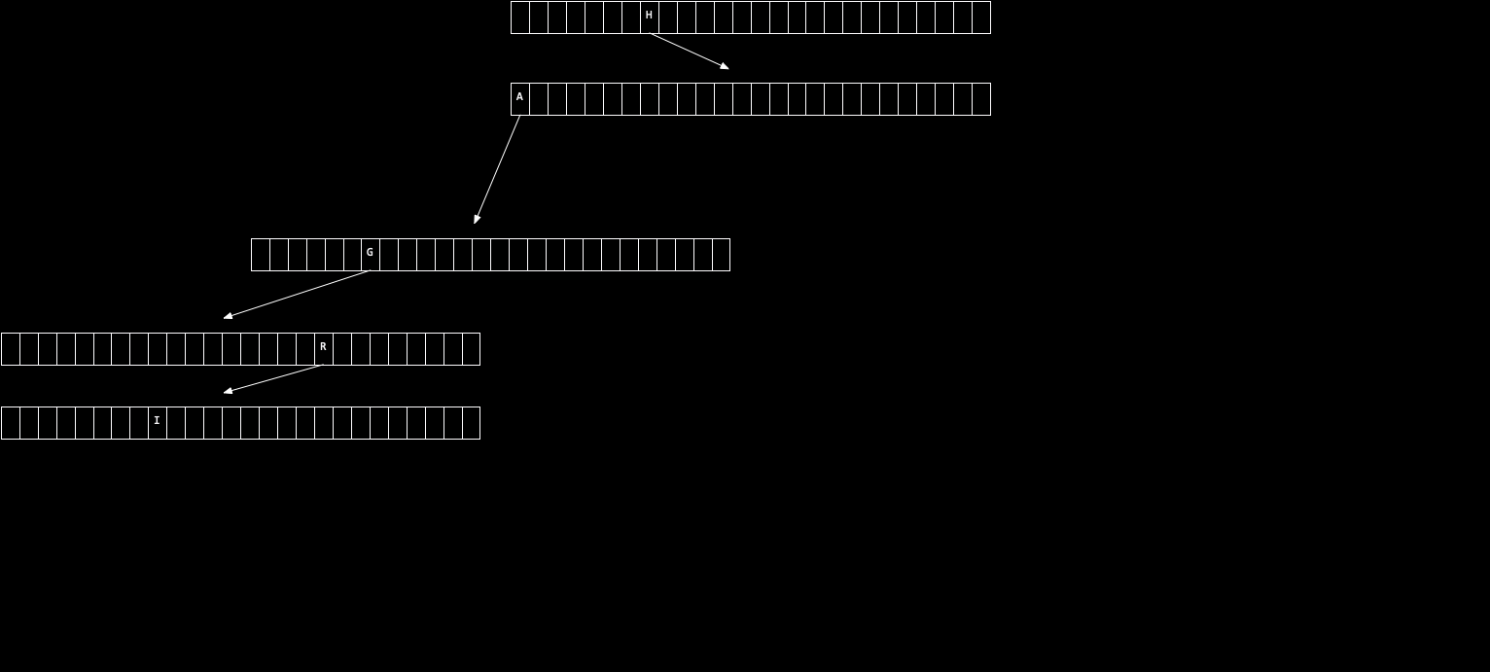

Slide 203
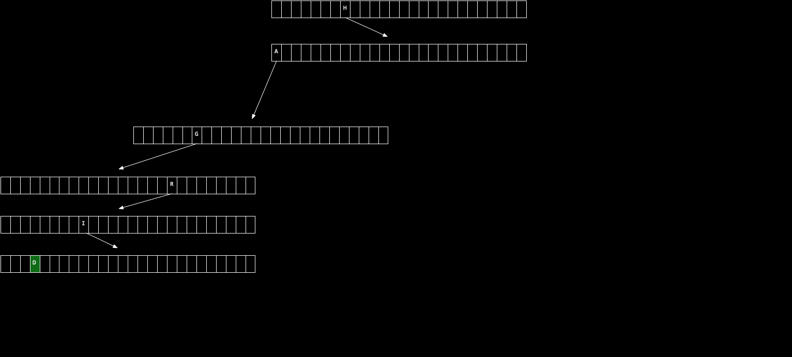

Slide 204
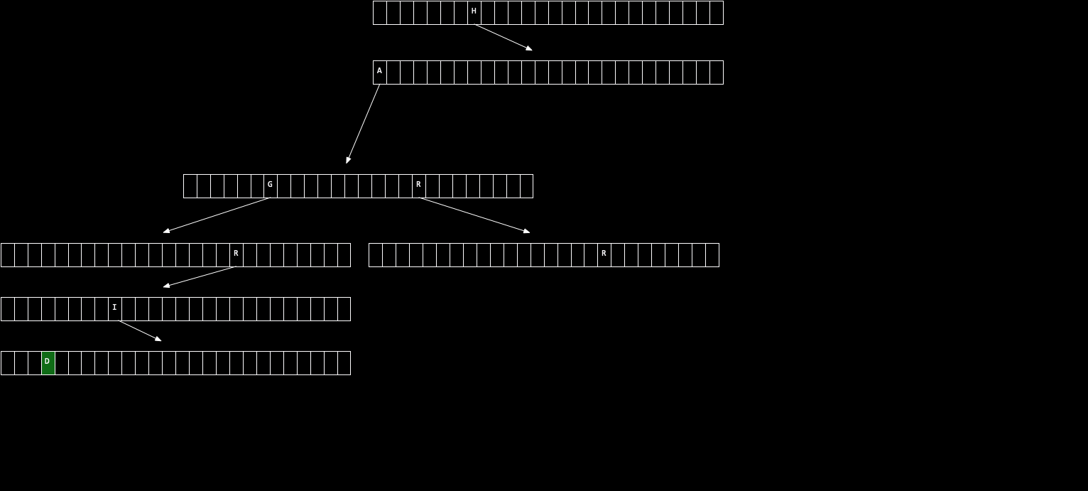

Slide 205
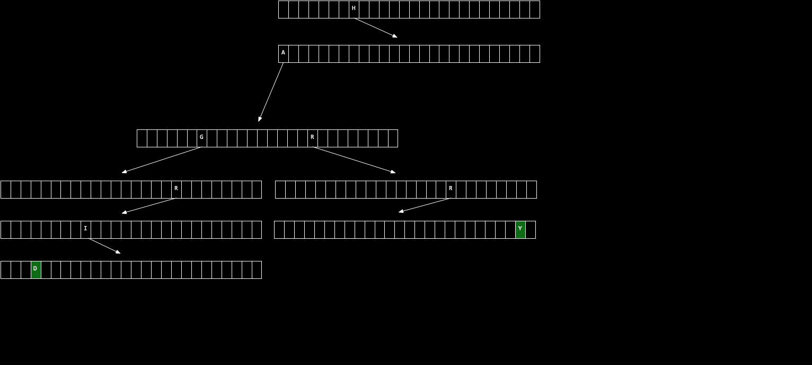

Slide 206
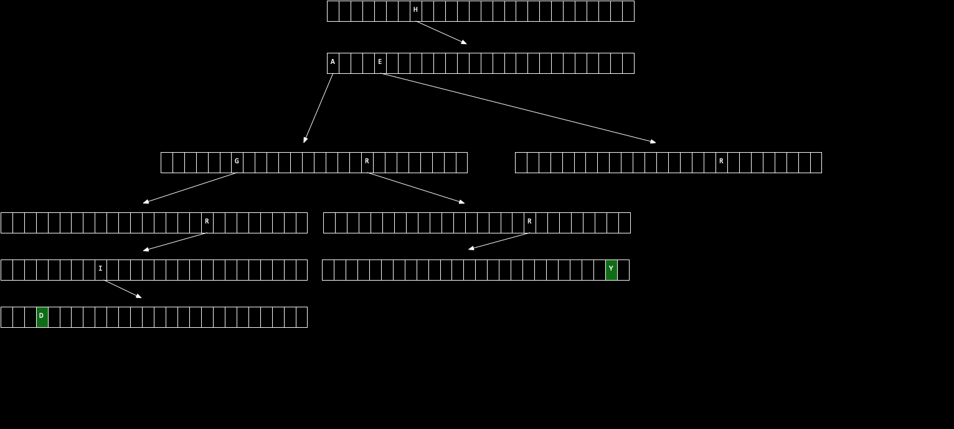

Slide 207
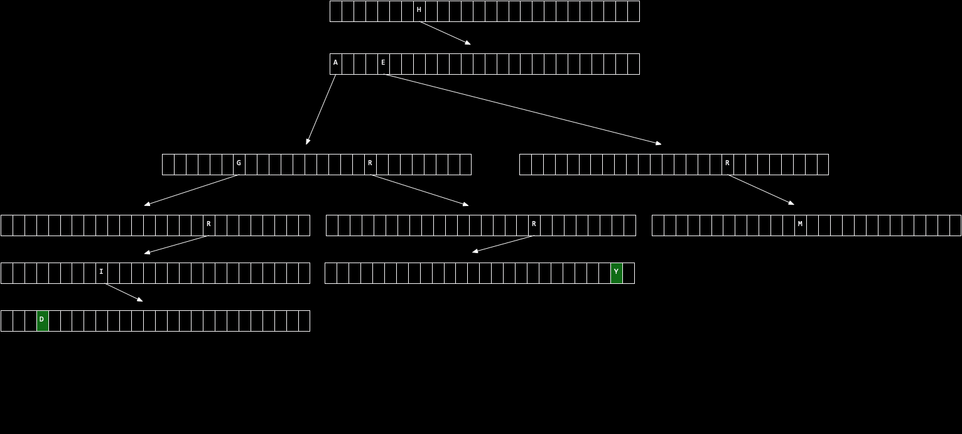

Slide 208
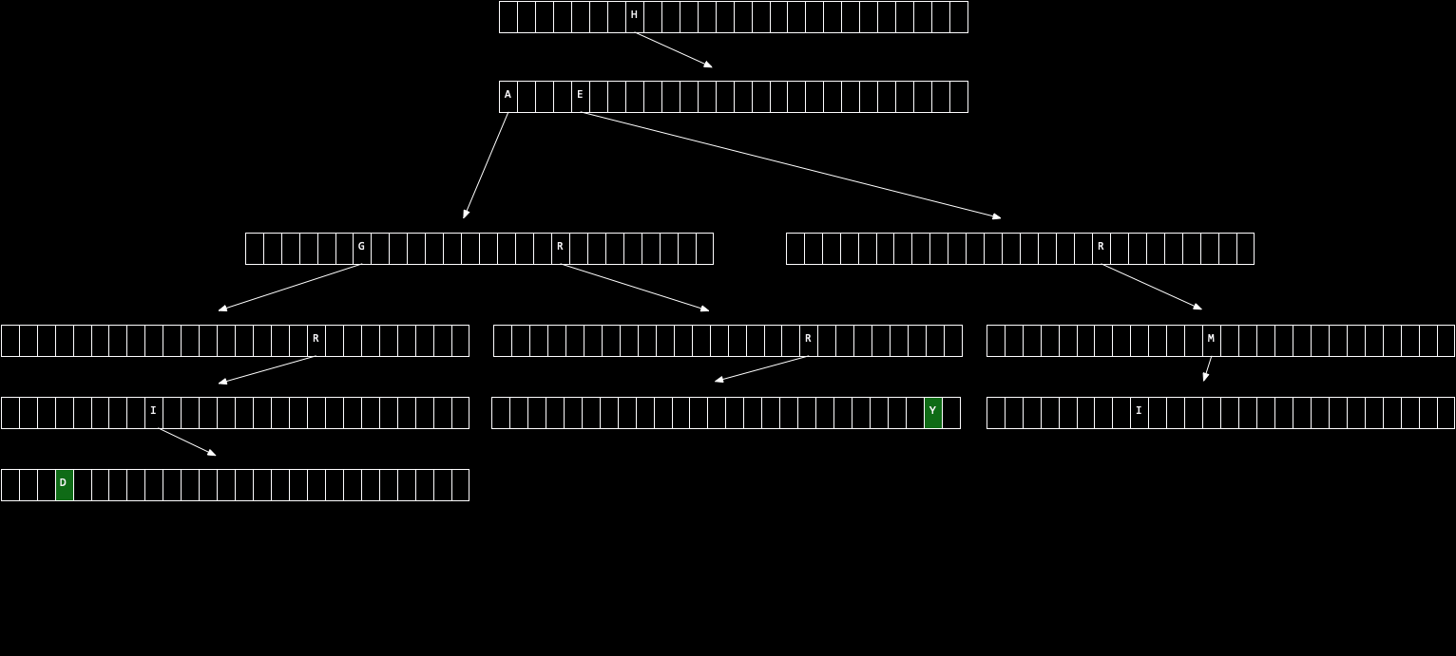

Slide 209
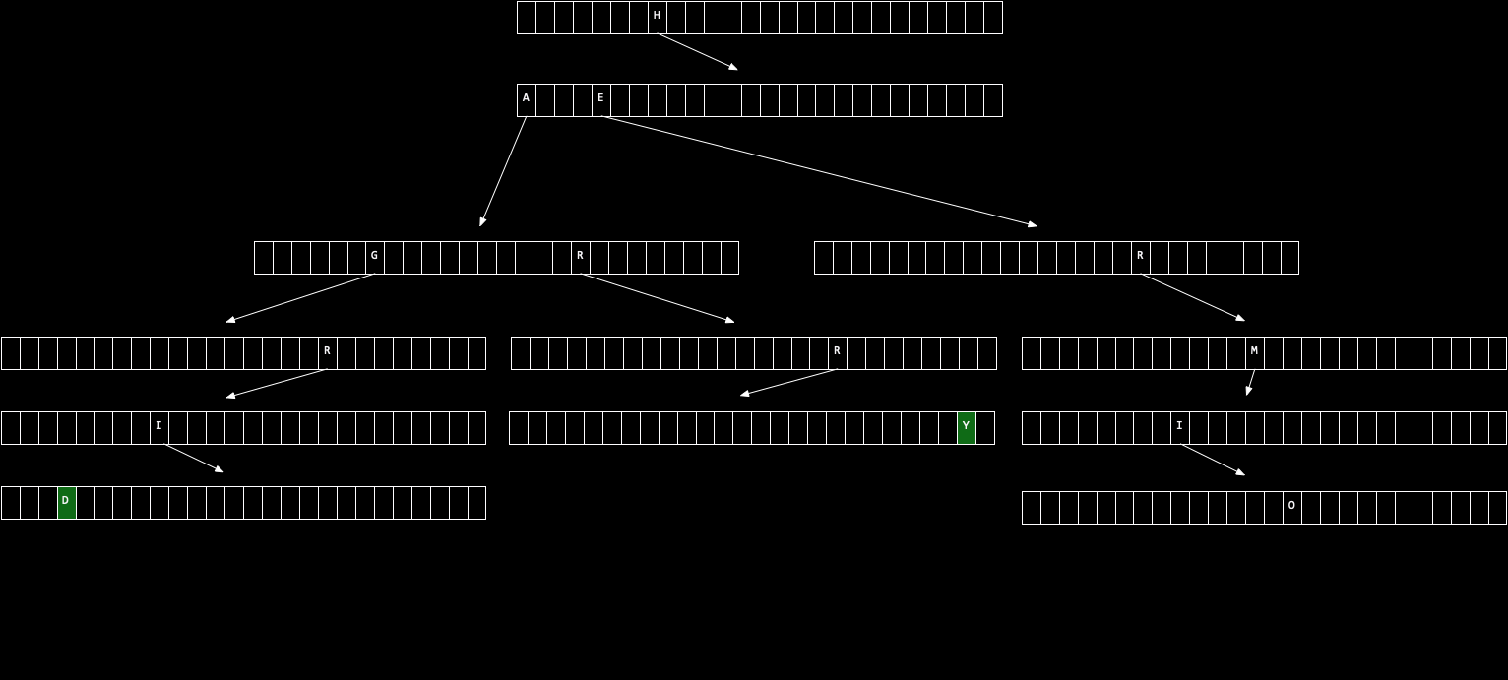

Slide 210
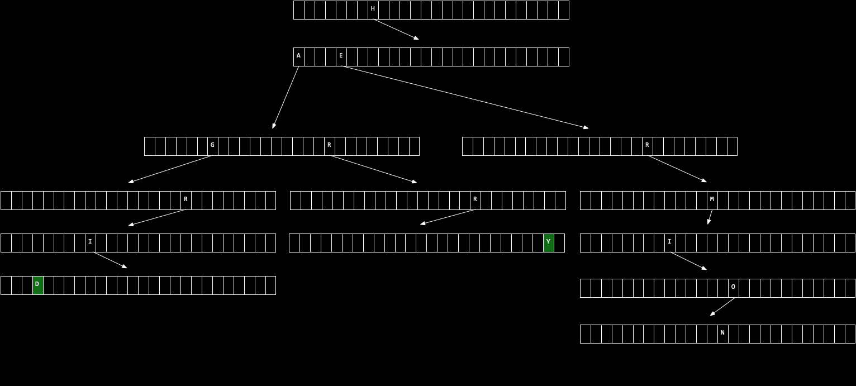

Slide 211
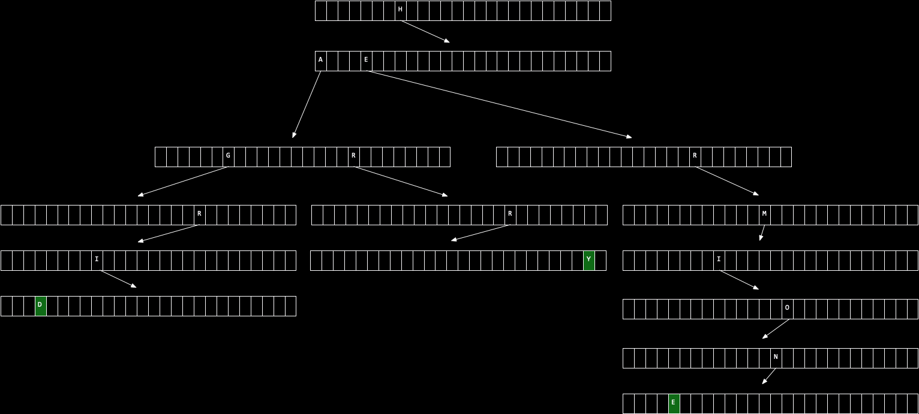

Slide 212
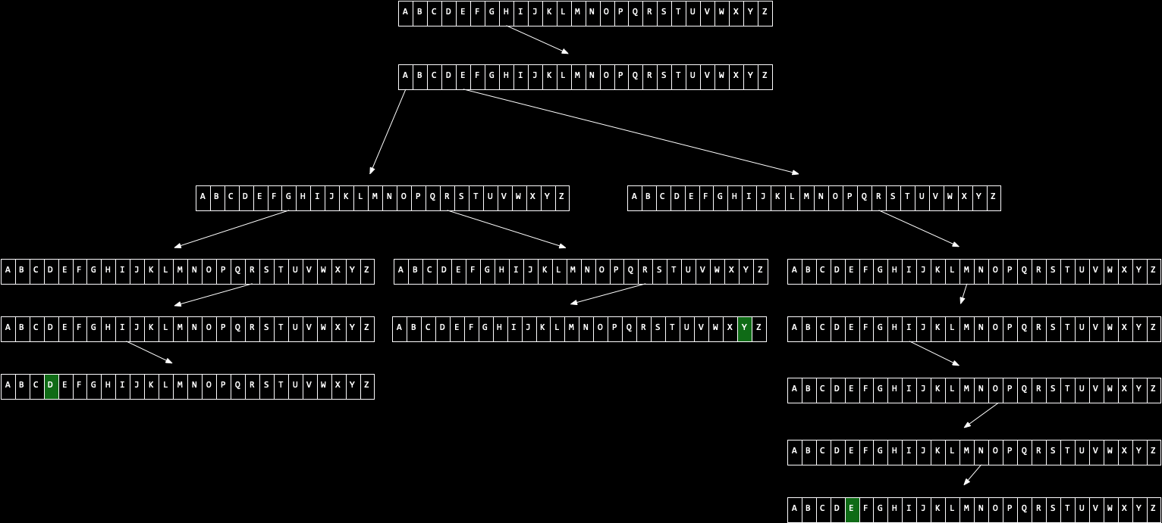

Slide 213
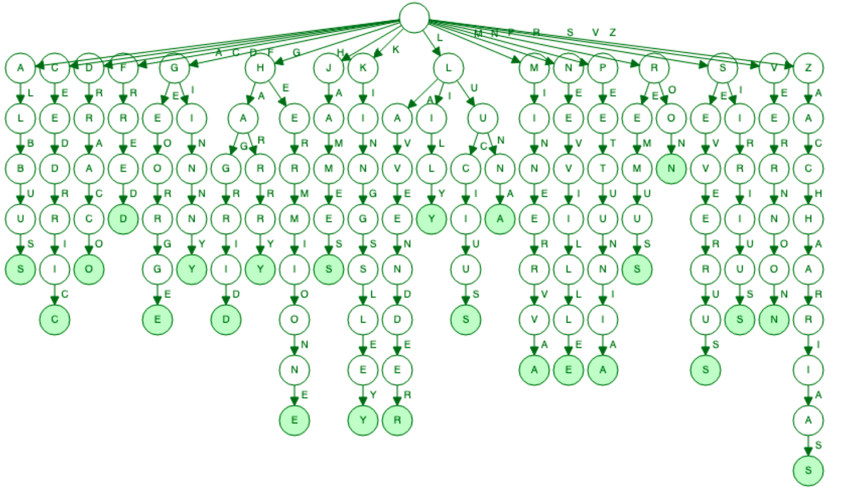
Notes:
https://www.cs.usfca.edu/~galles/visualization/Trie.html

Slide 214
O(n²)
O(n log n)
O(n)
O(log n)
O(1)

Slide 215
O(k) search

Slide 216
O(k) search, insert

Slide 217
O(1) search, insert

Slide 218
O(n²)
O(n log n)
O(n)
O(log n)
O(1) search, insert

Slide 221
abstract data structures

Slide 222
queues
Notes:
- line at Tasty Burger
- printer queue

Slide 223
enqueue
dequeue

Slide 224
FIFO

Slide 225
stacks
Notes:
- stack of trays
- Gmail inbox

Slide 226
push
pop
Notes:
memory.c

Slide 227
LIFO

Slide 228
dictionaries

Slide 229
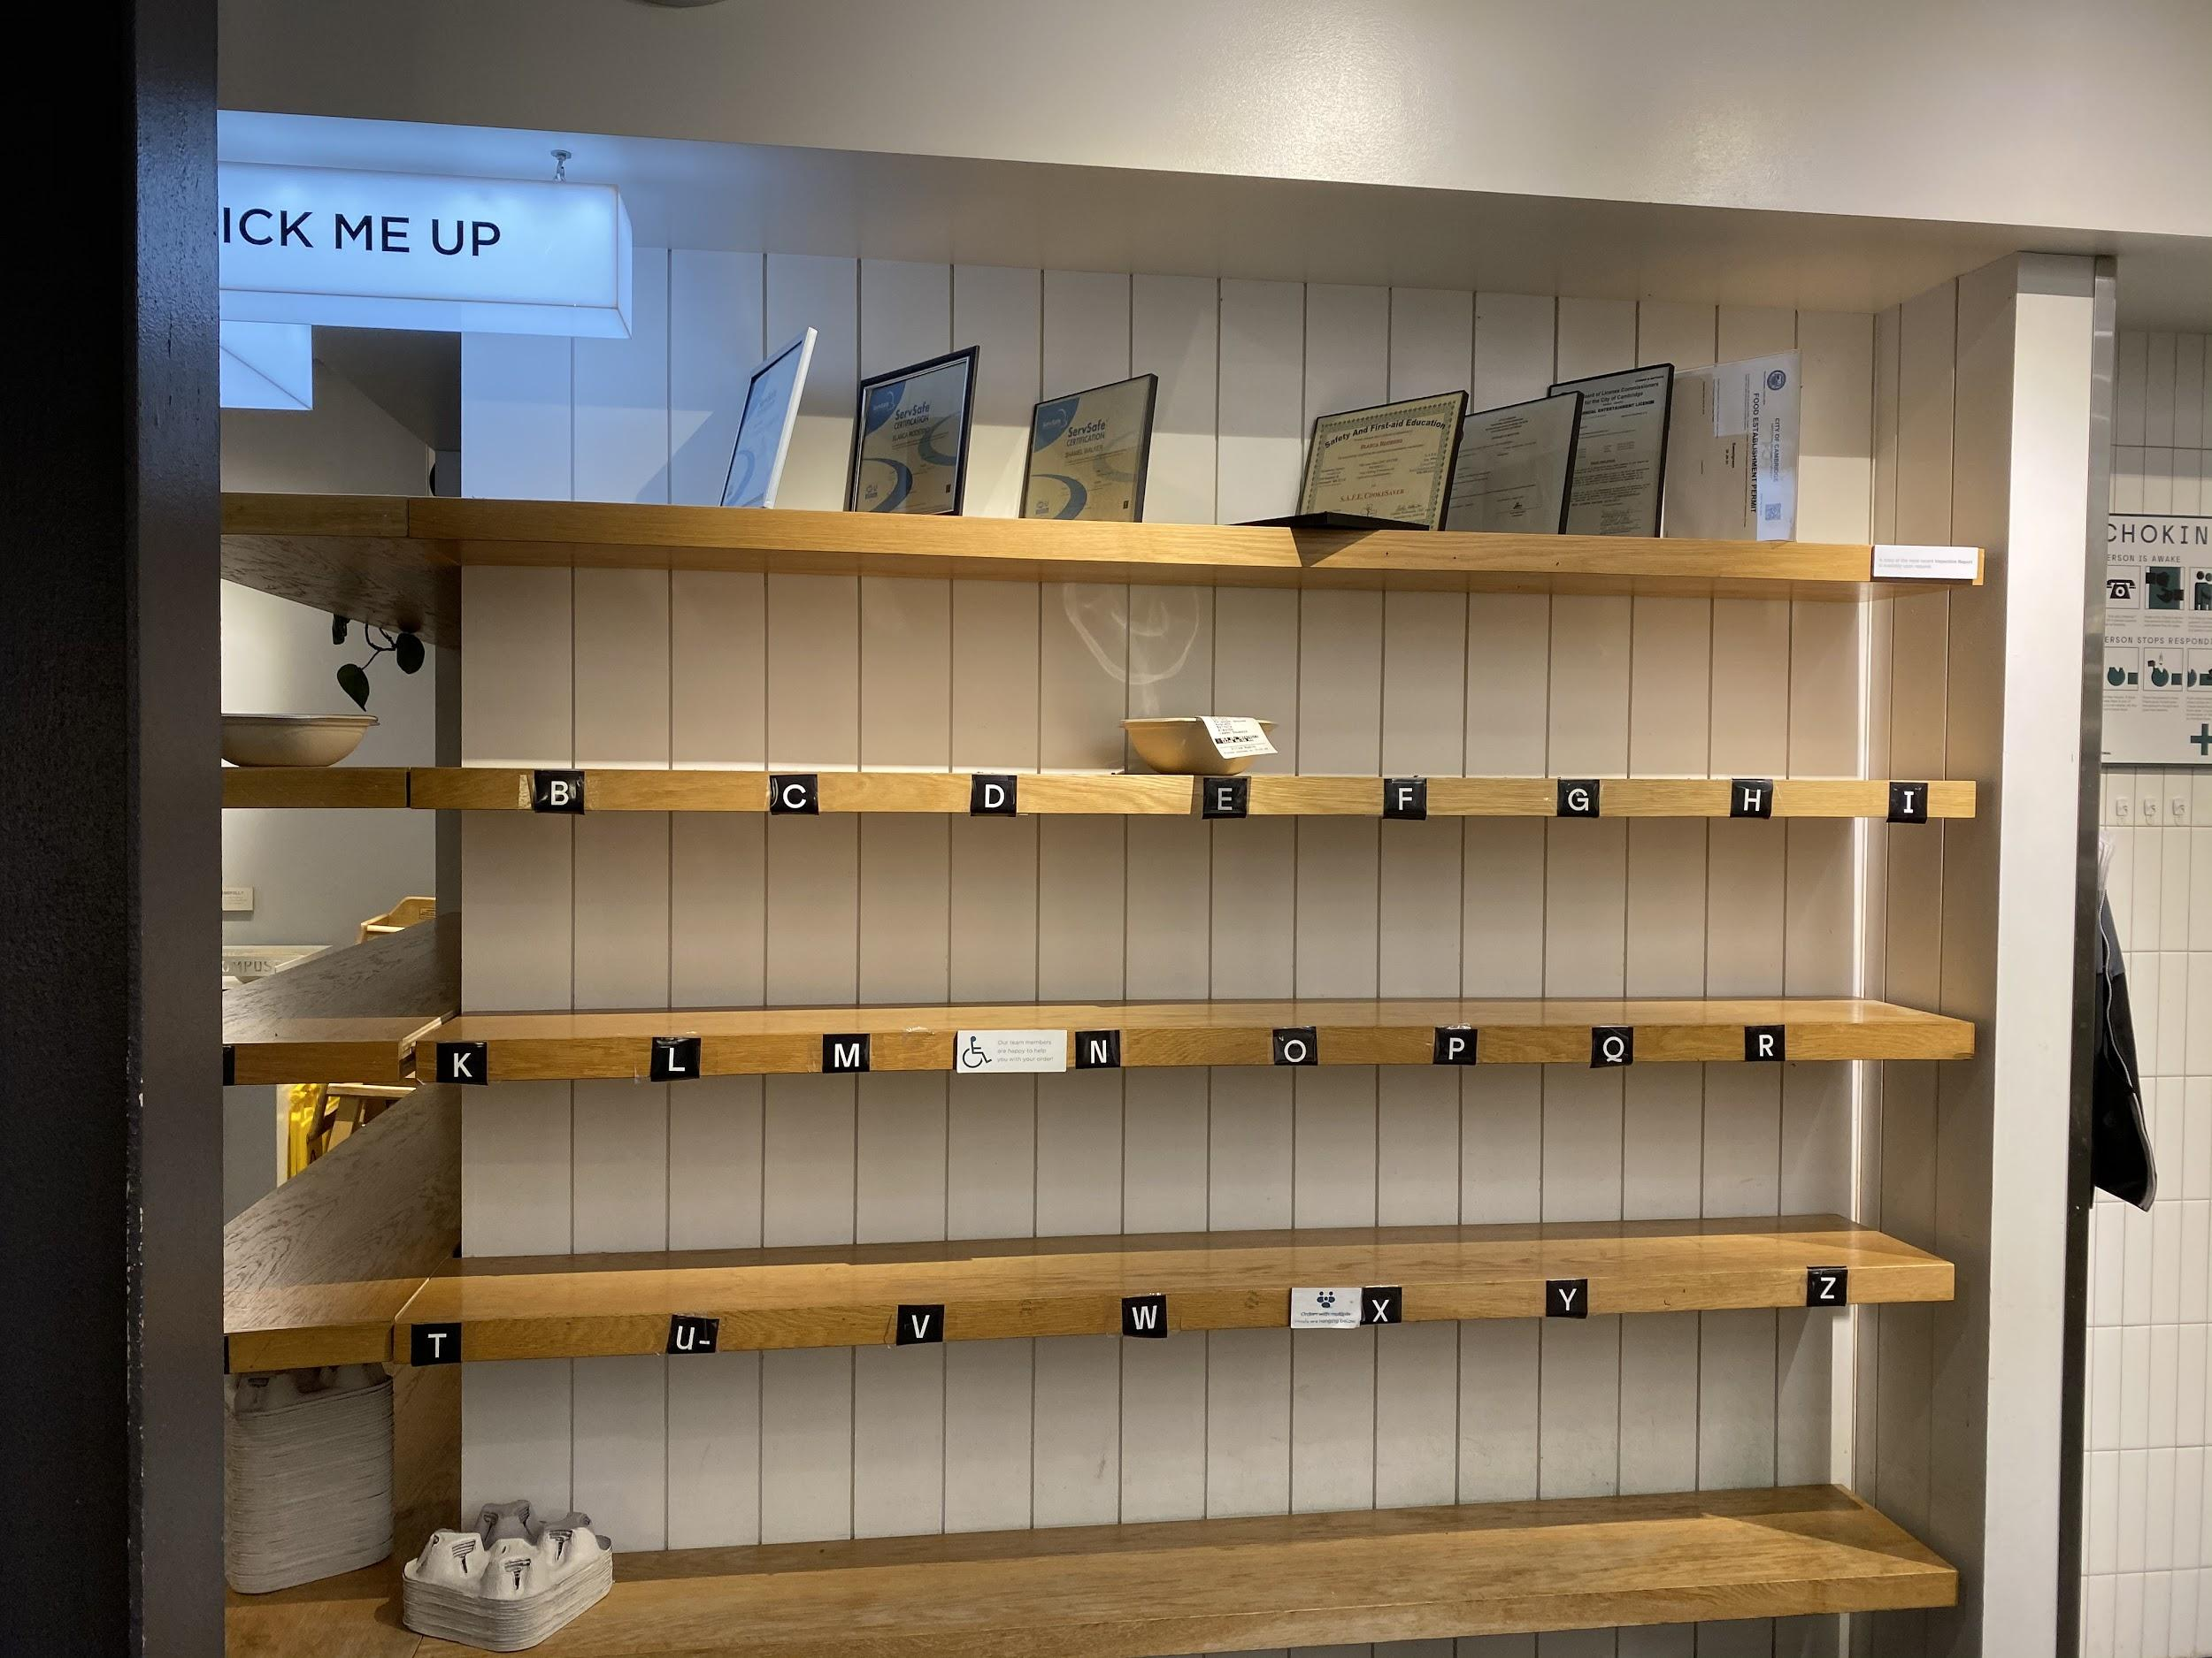

Slide 230
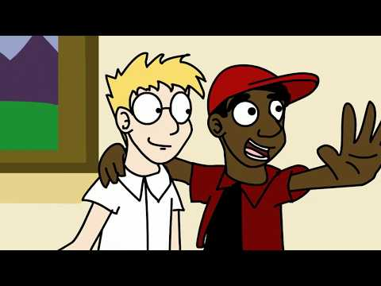

Slide 231
This is CS50

